Slide 1
Your Superpowered Windows Infrastructure Toolkit: Ansible, PowerShell, and Chocolatey
Josh King

Slide 2

Who am I?
Josh King
ToastIT.dev
@windos@mastodon.nz
Infrastructure Ops Engineer @ Chocolatey

Slide 3






A Typical Windows Infrastructure Toolkit

Slide 4
What Are we talking about today?
Finding a place for Ansible flavored Infrastructure as Code in your personal toolkit
Specifically in a Windows environment
Not throwing out your investment in PowerShell
Easy software management with Chocolatey

Slide 5








Why Ansible?
Infrastructure Provisioning
Configuration Management
Infrastructure as Code

Slide 6
Terminology
Ansible
PowerShell
Collections
Modules
Roles
Playbooks
Modules
Cmdlets
Functions
Script files

Slide 7
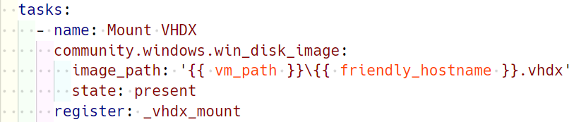
A Note on The YAML
Module
Collection
{{ variables }}
Task Keywords
Module Parameters

Slide 8
What’s Chocolatey?
Package Manager for Windows (think apt/yum/dnf on Linux or Homebrew on macOS)
Install, Upgrade, Uninstall packages from the command line
Access to over 9,000 packages via the Chocolatey Community Repository
Has been available for over 12 years
There are commercial components available that extend Chocolatey (and pay my bills), but everything we’re covering today is free

Slide 9
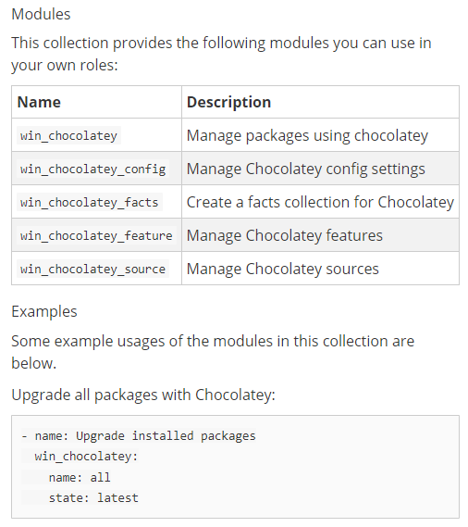
Chocolatey + Ansible?
First party Ansible Collection: chocolatey.chocolatey
Allows for managing packages, and other Chocolatey features and configuration
Idempotence for free (re-run playbooks and only make changes when changes are needed)
It’s fun to try and say “chocolatey.chocolatey.win_chocolatey” on a video call

Slide 10

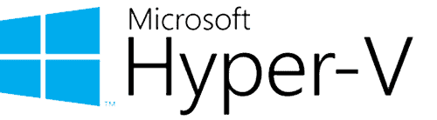

The Demo LAB
WinRM
Azard
Havok

Slide 11
DEMO
I need me some VMs

Slide 12
The Demo LAB
Atrius
Bane
WinRM
Azard
Havok

Slide 13
DEMO
Config time

Slide 14
Key Takeaways
Learn to love YAML… and indents
Need WinRM configured on your Windows hosts
SSH is possible, but it’s experimental
Ansible tends to be Linux first
Leverage your PowerShell knowledge to plug gaps in existing collections
Use variables, make your configuration reusable
Jinja2 templates are awesome for reusing templates between prod and dev/test

Slide 15
Next Steps
Capture reusable groups of tasks as roles in a collection
Consider Ansible Automation Platform/AWX/Semaphore
Re-run playbooks periodically to ensure configuration is consistent

Slide 16
Thank You! 💜
Get this slide deck and demo code from:
https://toast.click/Summit2023
Questions? Hit me up on Mastodon:
@windos@mastodon.nz

